Slide 1

Chapter 3
Using Hyperlinks to Connect Content

Slide 2
Learning Objectives
How to use the <a> and </a> anchor tag pair to create a text-based hyperlink.
How to use the anchor tag target attribute to open a hyperlink in a new window.
How to use relative and absolute URLs to create a hyperlink.
How to use the <a> and </a> anchor tag pair to create an image-based hyperlink.
How to create an in-page hyperlink.
How to use the mailto attribute within a hyperlink to open an e-mail client.
How to create an image map.

Slide 3

Creating a hyperlink
<!DOCTYPE html> <html> <body> <a href="http://www.google.com">Goto Google</a> </body> </html>

Slide 4
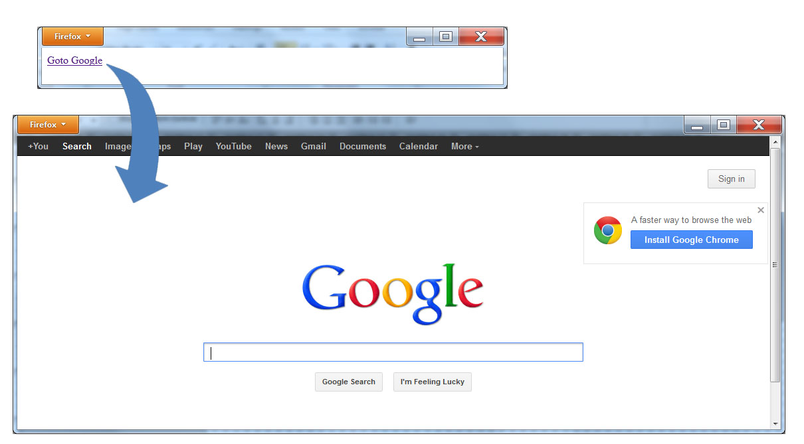
Following a hyperlink

Slide 5
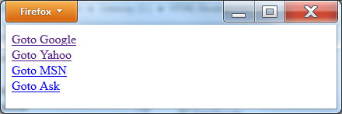
Multiple hyperlinks
<!DOCTYPE html> <html> <body> <a href="http://www.google.com">Goto Google</a><br/> <a href="http://www.Yahoo.com">Goto Yahoo</a><br/> <a href="http://www.MSN.com">Goto MSN</a><br/> <a href="http://www.ask.com">Goto Ask</a><br/> </body> </html>

Slide 6
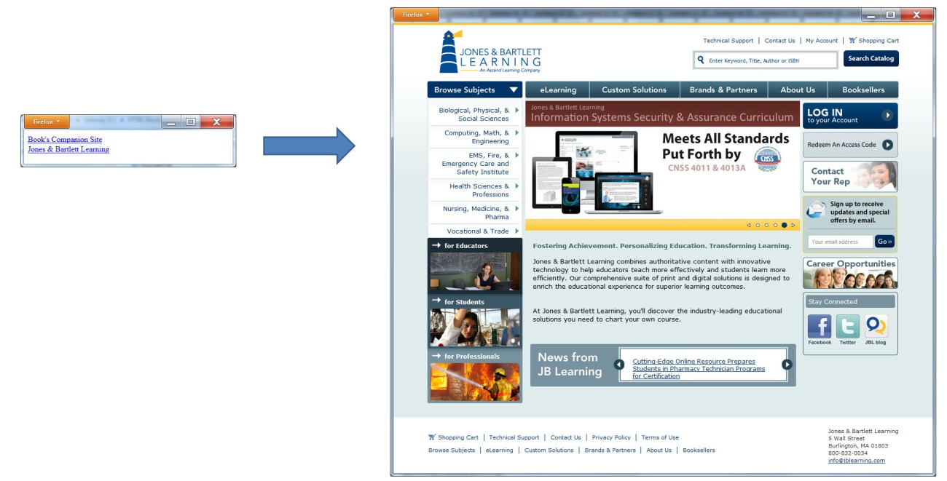
Opening a link in a new window
<!DOCTYPE html> <html> <body> <a href="http://www.WebSiteDevelopmentBook.com" target="new"><h1>Book's Companion Site</h1></a><br/> </body> </html>

Slide 7
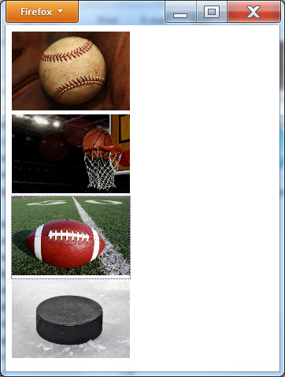
Using an Image as a Hyperlink
<!DOCTYPE html> <html> <body> <a href="http://www.mlb.com" target="new"><img src="http://www.WebSiteDevelopmentBook.com/Chapter03/Baseball.jpg" height="100" width="150"></a><br/> <a href="http://www.nba.com" target="new"><img src="http://www.WebSiteDevelopmentBook.com/Chapter03/Basketball.jpg" height="100" width="150"></a><br/> <a href="http://www.nfl.com" target="new"><img src="http://www.WebSiteDevelopmentBook.com/Chapter03/Football.jpg" height="100" width="150"></a><br/> <a href="http://www.nhl.com" target="new"><img src="http://www.WebSiteDevelopmentBook.com/Chapter03/Hockey.jpg" height="100" width="150"></a><br/> </body> </html>

Slide 8
Absolute hyperlinks
<a href=“http://www.somesite.com/homepage.html”>Home Page</a>
<a href=“http://www.somesite.com/aboutus.html”>About Us</a>
<a href=“http://www.somesite.com/contactus”>Contact Us</a>

Slide 9
Relative hyperlinks
<a href=“ homepage.html”>Home Page</a>
<a href=“ aboutus.html”>About Us</a>
<a href=“ contactus”>Contact Us</a>

Slide 10
Same page hyperlinks
<a href="#One">One</a>
<a href="#Two">Two</a>
<a href="#Three">Three</a><br/>
<a name="One"></a>

Slide 11
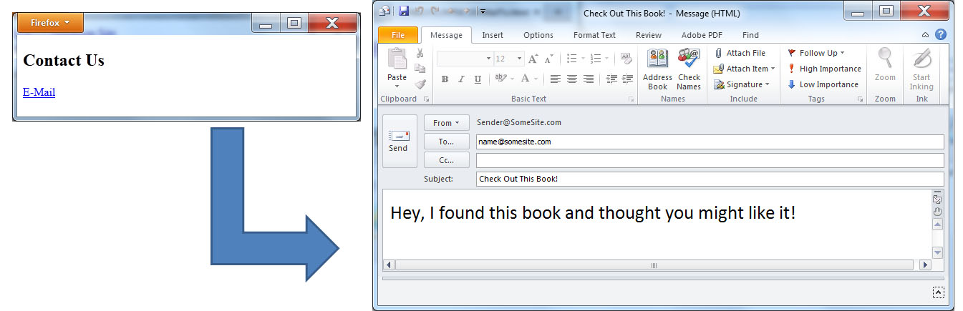
Creating a mailto link
<!DOCTYPE html> <html> <body> <h2>Contact Us</h2> <a href="mailto:name@somesite.com?subject=Check Out This Book!&body=Hey, I found this book and thought you might like it!">E-Mail</a> </body> </html>

Slide 12
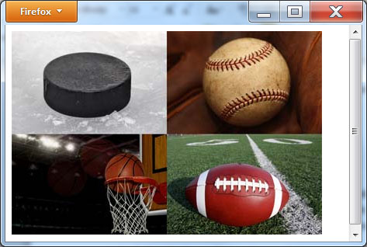
Creating an image map
<!DOCTYPE html> <html> <body> <img src="http://www.WebSiteDevelopmentBook.com/Chapter03/Sports.jpg" usemap="#Sports" /> <map name="sports"> <area shape="rect" coords="1,1,200,131" href="http://www.nhl.com" /> <area shape="rect" coords="201,1,400,131" href="http://www.mlb.com" /> <area shape="rect" coords="1,132,201,262" href="http://www.nba.com" /> <area shape="rect" coords="201,132,400,262" href="http://www.nfl.com" /> </map> </body> </html>

Slide 13
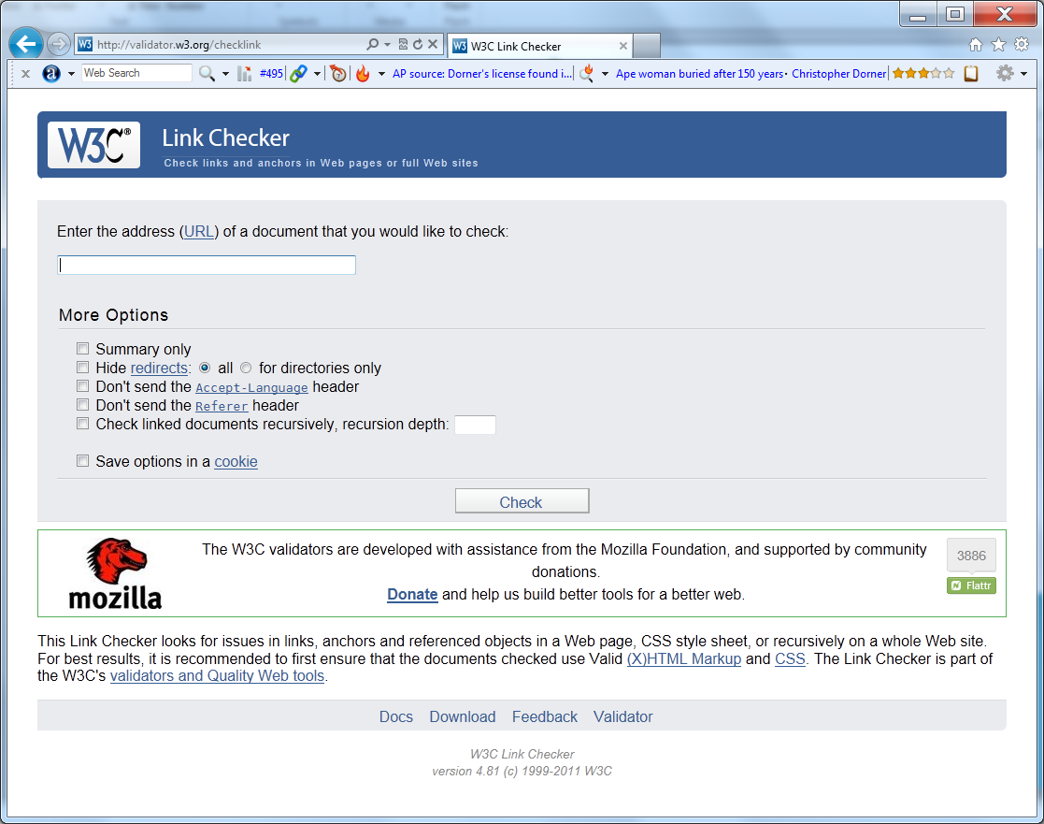
Real-world: http://validator.w3.org/checklink

Slide 14
summary
To create the World Wide Web developers have created HTML files which use hyperlinks to connect documents.
In general, the Web is a network of billions of interconnected pages of content, linked together by hyperlinks.
When viewing Web pages within a browser, users click on a hyperlink to move from one document to another or from one location on page to another.
A hyperlink can be text, which normally appears within the browser in blue or purple and is underlined, or, the hyperlink can be a photo.
To place a hyperlink within the Web pages, you create, you use the <a> and </a> anchor-tag pairs.

